Slide 1
Principles of Design in Art
Balance
Contrast
Rhythm
Movement
Emphasis
Pattern
Unity
Proportion
Scale

Slide 2
Balance - the impression of equilibrium in a pictorial or sculptural composition. Balance is often referred to as symmetrical, asymmetrical, or radial.

Slide 3
Contrast - refers to the arrangement of opposite elements (light vs. dark colors, rough vs. smooth textures, large vs. small shapes, etc.) in a piece so as to create visual interest, excitement and drama.

Slide 4
Rhythm / movement - refers to the suggestion of motion through the use of various elements.
Movement is the path the viewer’s eye takes through the work of art, often to focal areas. Such movement can be directed along lines, edges, shape, and color within the work of art.
Rhythm is created when one or more elements of design are used repeatedly to create a feeling of organized movement. Rhythm creates a mood like music or dancing. To keep rhythm exciting and active, variety is essential.

Slide 5
Emphasis - refers to the created center of interest, the place in an artwork where your eye first lands.
Emphasis is the part of the design that catches the viewer’s attention. Usually the artist will make one area stand out by contrasting it with other areas. The area could be different in size, color, texture, shape, etc.

Slide 6
Pattern - refers to the repetition or reoccurrence of a design element, exact or varied, which establishes a visual beat.
Repetition works with pattern to make the work of art seem active. The repetition of elements of design creates unity within the work of art.

Slide 7
Unity - is achieved when the components of a work of art are perceived as harmonious, giving the work a sense of completion.
Variety is the use of several elements of design to hold the viewer’s attention and to guide the viewer’s eye through and around the work of art.

Slide 8
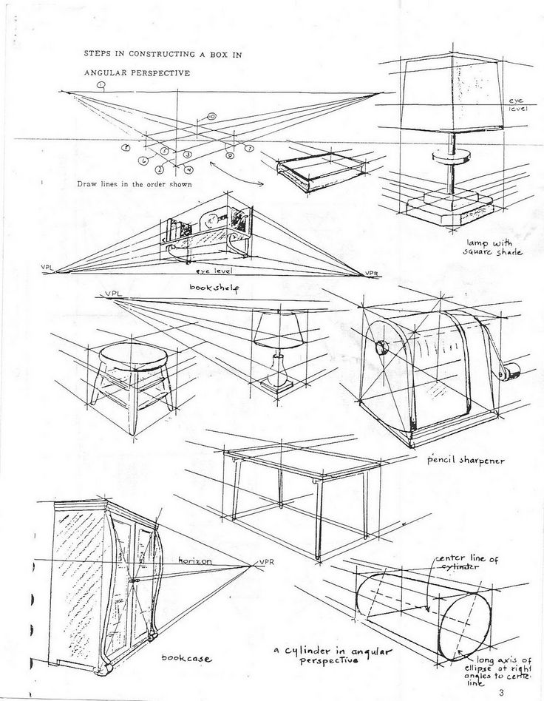
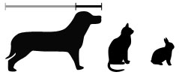
Proportion / Scale - is the size relationship of parts to a whole and to one another. Scale refers to relating size to a constant, such as a human body.

