Slide 1
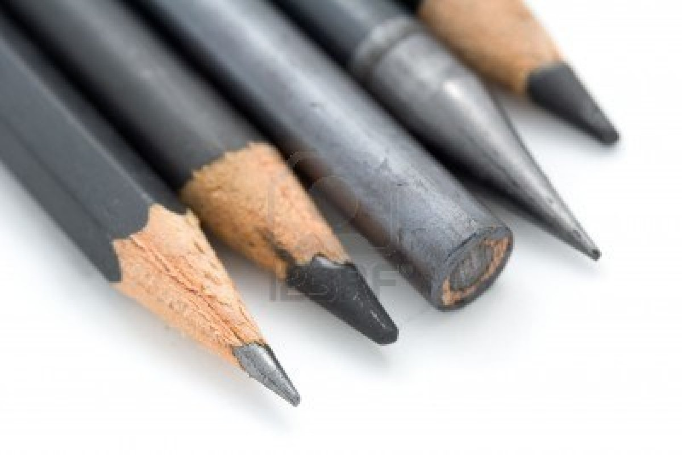
Pencils and their Value

Slide 2
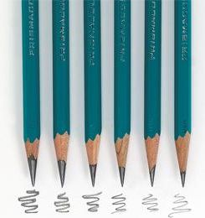
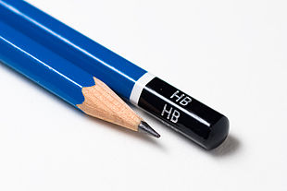
Pencils

Slide 3
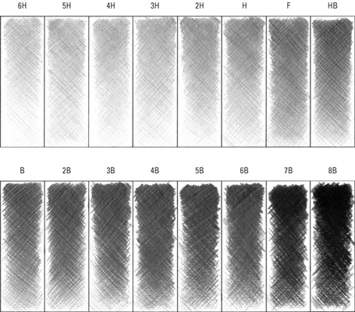
Pencil Value First Assignment

Slide 4
Pencil Value 2nd Assignment
What Pencils did you use? I want to know what pencils you used write them down
Use at least four different types of Pencils
Example
Layout Pencil 2H thru 6H
First Value cleaning up the image making the object look more like your image 2H thru HB
Second Value more cleaning of image darker value shading B thru 3B
Final Value darkest darks and shadows 4B thru Ebony
What is your object? Be as specific as you can
What box of Pencils did you use? Put the name of the color on your drawing so you can use the same box tomorrow and the next day.

