Slide 1
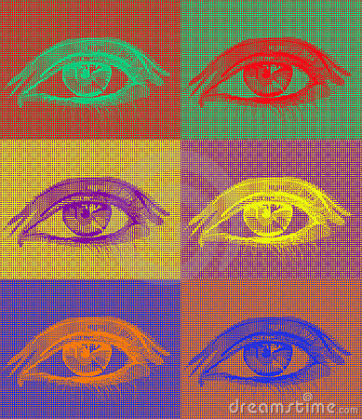
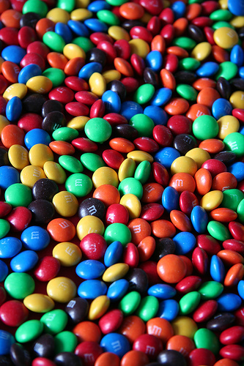
Color Theory

Slide 2
COLOR HAS THREE DIMENSIONS OR QUALITIES:
Hue
Value
Intensity

Slide 3
HUE
The color itself
The name given to a color

Slide 4
VALUE
Lightness or darkness of a color (tints/shades)
Shade: a dark value of a color-
ex: maroon = red + black
Tint: a light value of a color-
ex: pink = red + white

Slide 5
INTENSITY
Brightness or dullness of color (hue)

Slide 6
Color
Primary
Secondary
Compliment
Tertiary
Analogous

Slide 7
Primary Colors
Colors that cannot be created by mixing other colors.

Slide 8
Secondary Colors created by mixing equal parts of two primary colors together

Slide 9
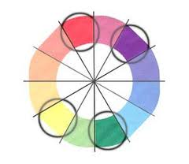
Complimentary Colors
Colors that are directly opposite of each other on the color wheel (ex. Yellow and violet)

Slide 10
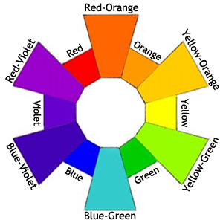
Tertiary Colors
created by mixing a primary and secondary color together.

Slide 11
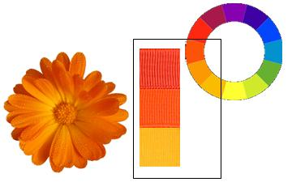
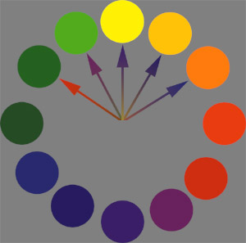
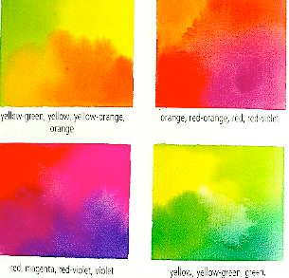
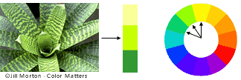
Analogous Colors:
Colors right next to each other on the
color wheel.

Slide 12
All colors have a temperature!
On a traditional color wheel: yellow-green to violet are considered cool, whereas yellow to red-violet are considered warm.

Slide 13
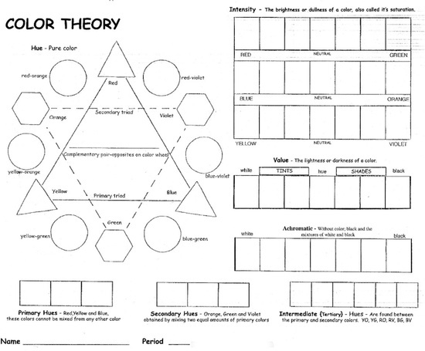

Slide 14
Create your own color wheel!

Slide 15
Step #1: Sketch & Label

Slide 16
Sketch & Label

Slide 17
Step #2: Add primary colors

Slide 18
Step #3: Add secondary colors

Slide 19
Step #4: Creating tertiary colors

